Slide 1

DSA Using C
Lab Tasks

Slide 2
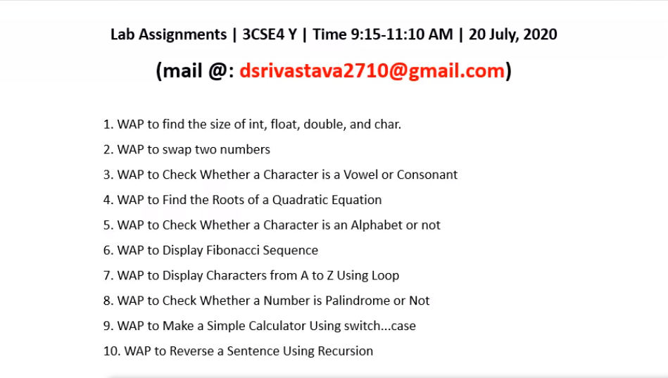

Slide 3
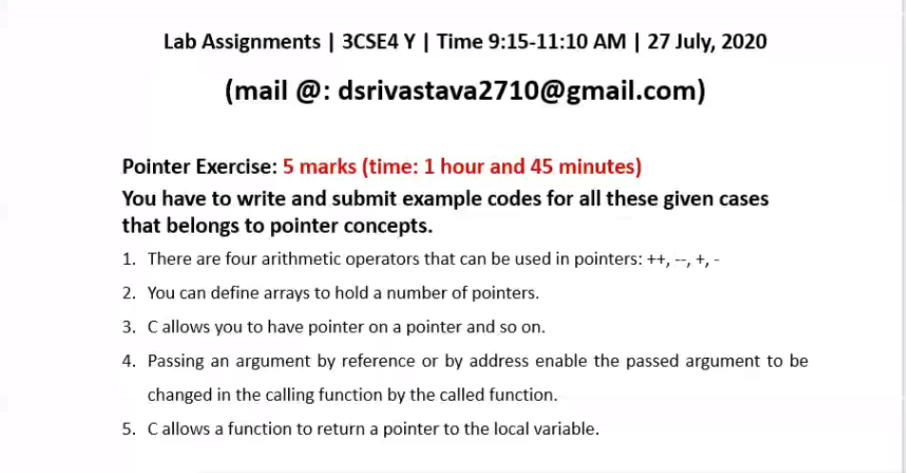

Slide 4
Write a program to perform the push and pop operations in stack data structure.
WAP to print the reverse of the stack.
WAP to perform insertion, deletion ,update ,traversal in an array. Perform all the three cases of insertion, deletion
WAP to print the first and the last element of the stack.
WAP to merge two arrays
WAP to check whether a matrix is a sparse matrix or not.
WAP to perform peek operation in queues.
WAP to delete a node in a singly linked list when the data of the node is given
WAP to delete a node next to the given node in single linked list.

Slide 5
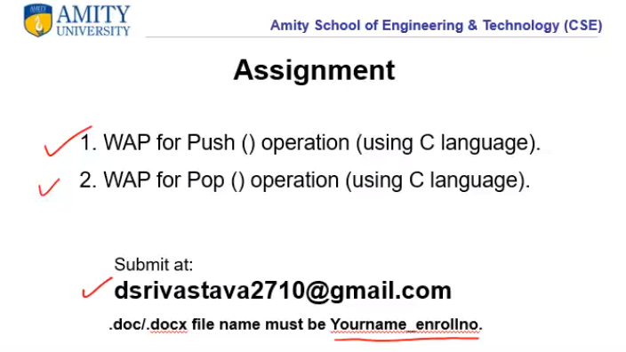

Slide 6
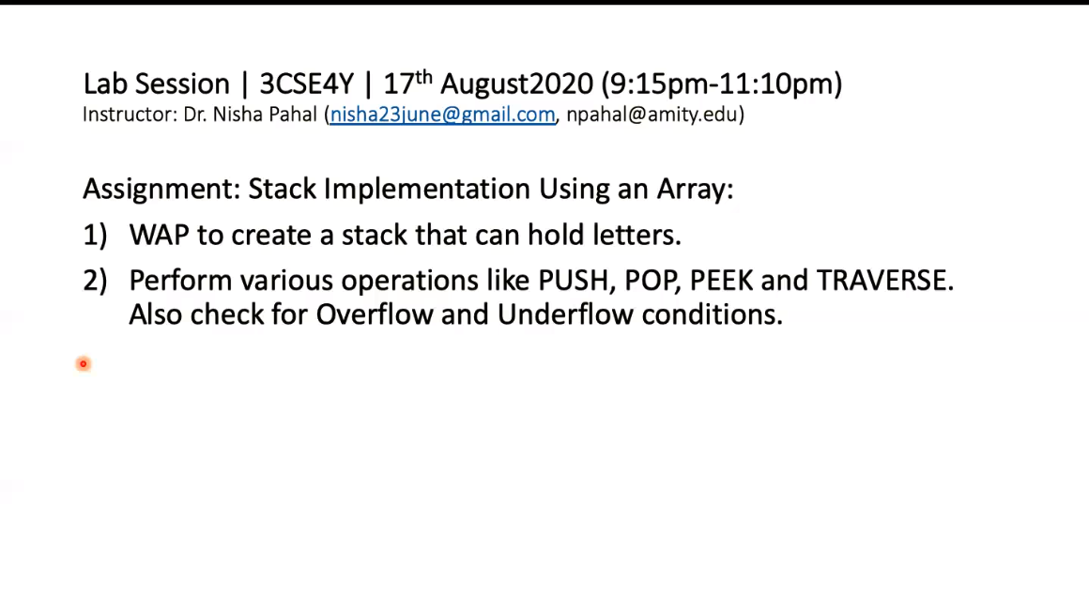

Slide 7
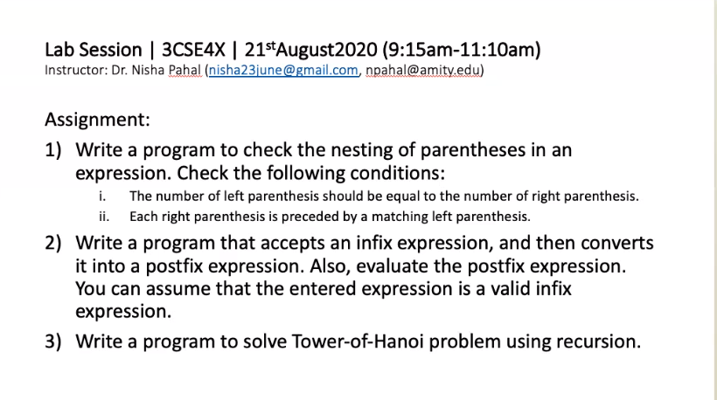

Slide 8
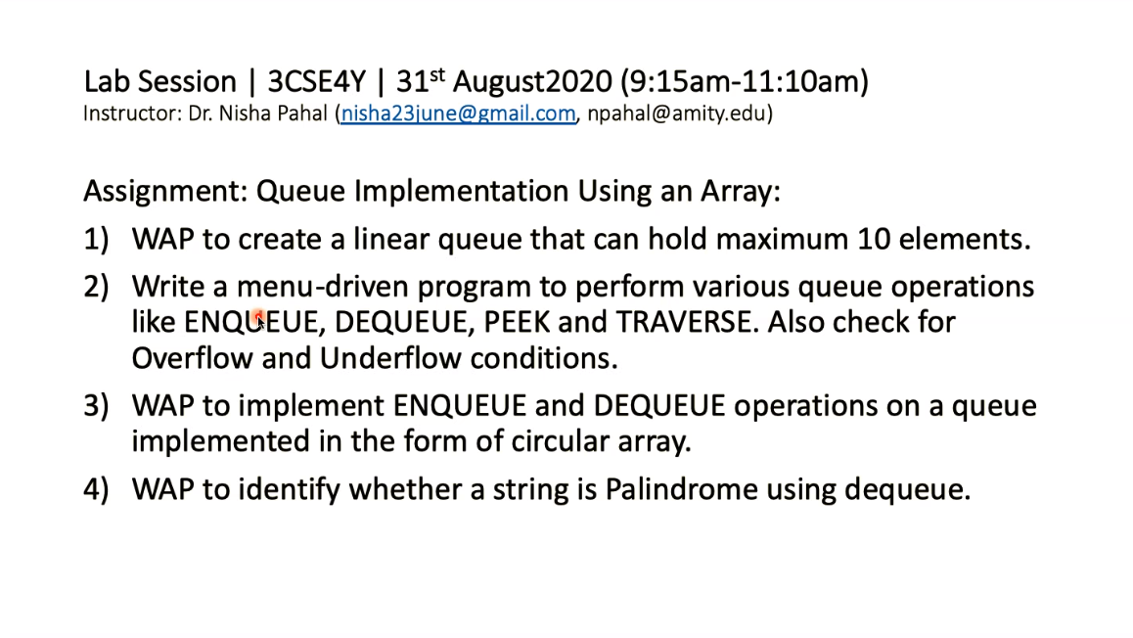

Slide 9
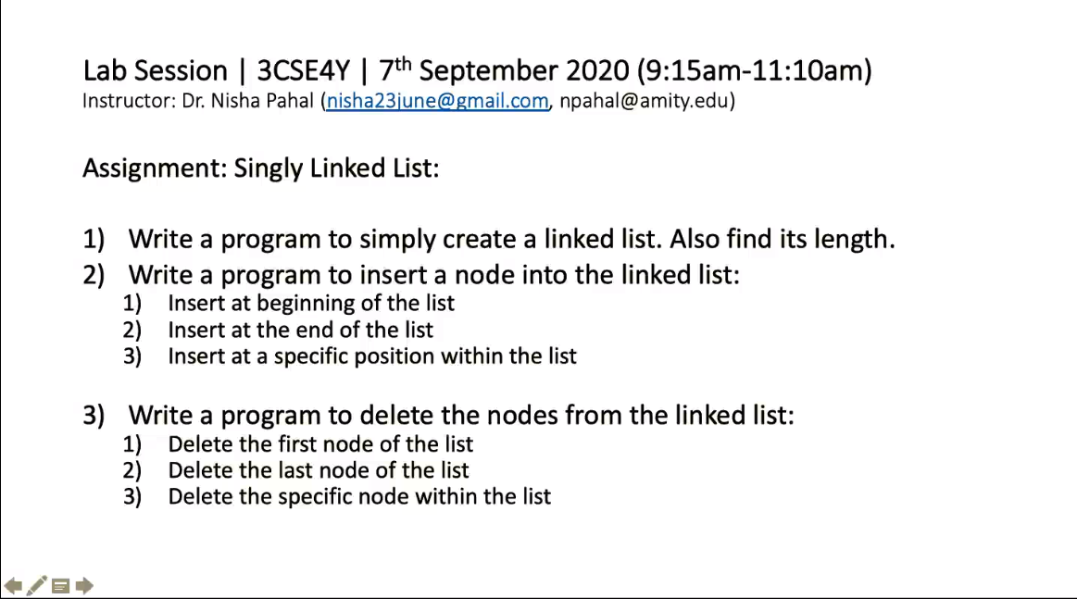

Slide 10
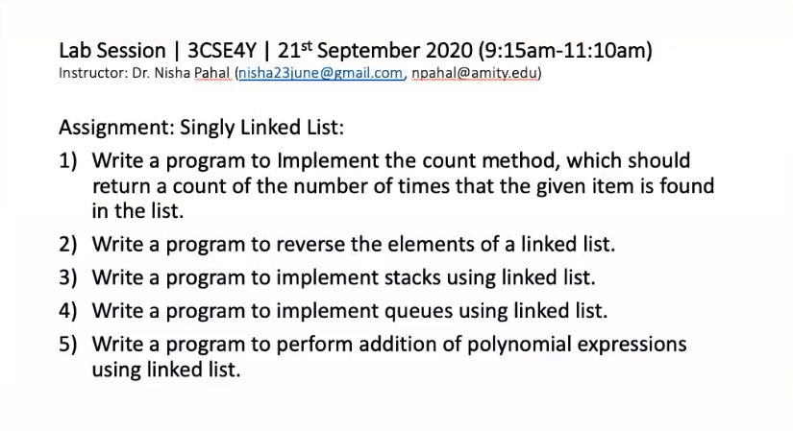

Slide 11
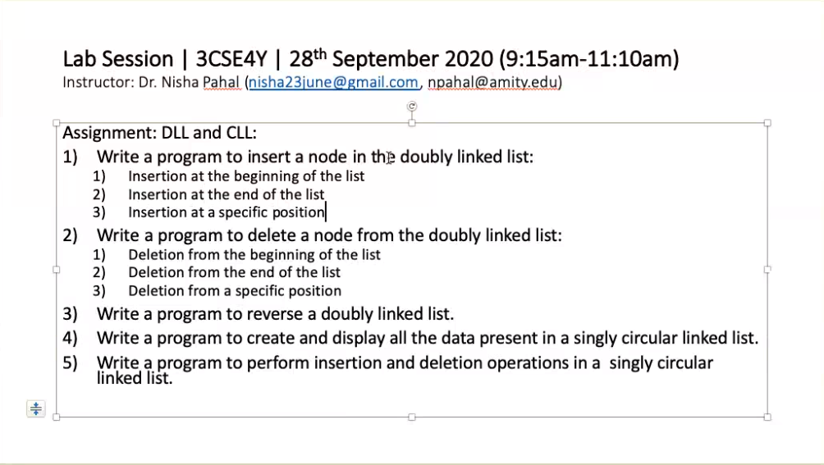

Slide 12
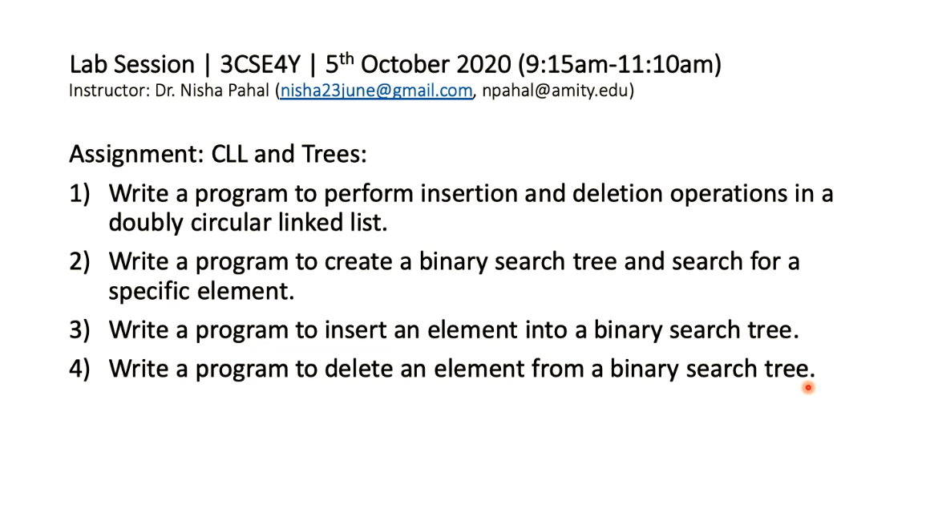

Slide 13
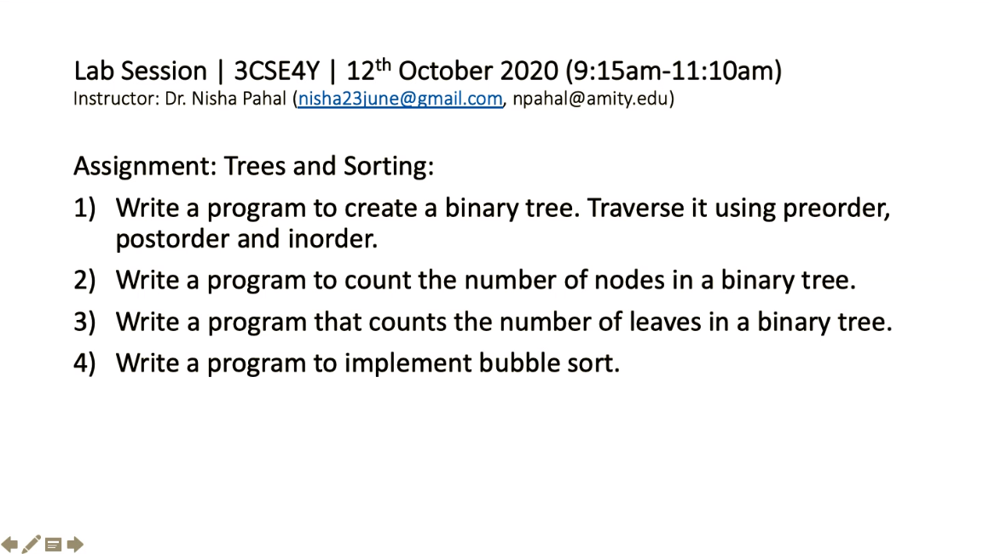

Slide 14
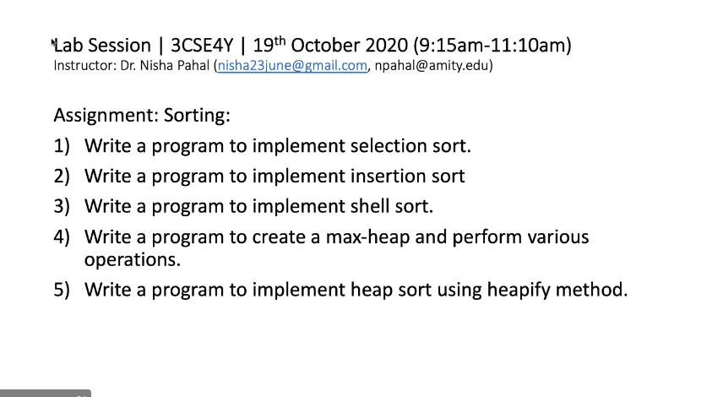

Slide 15
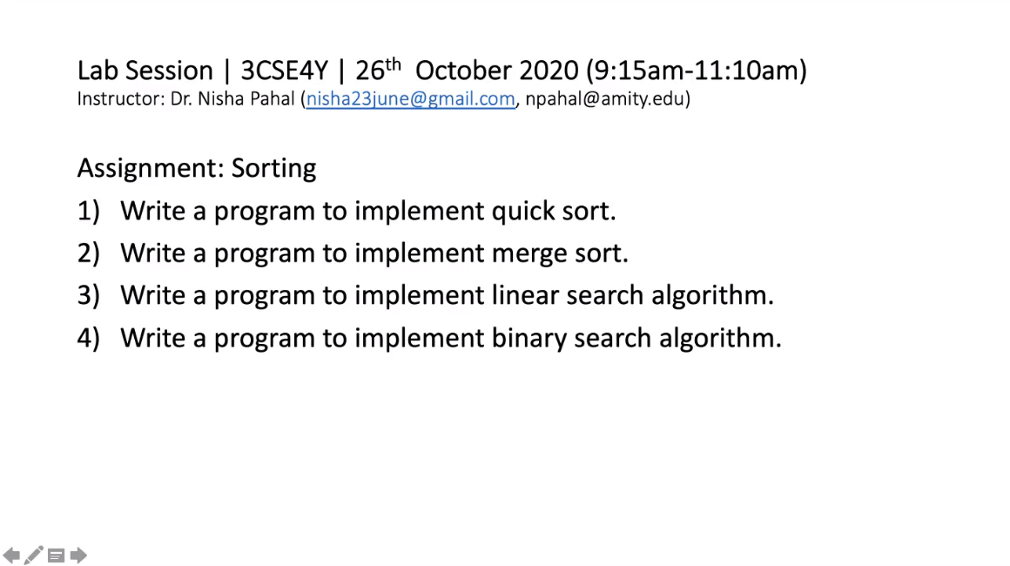

Slide 16
WAP to implement Warshalls algorithm.
WAP to traverse a graph using BFS.
WAP to traverse a tree using DFS.
WAP to implement Prims Algo to find MST.
WAP to implement Kruskals Algo To find MST.

